Slide 1
Developing a model to identify NSUN6 affected genes in mRNA
Joel Evans

Slide 2
Developing a model to identify NSUN6 affected genes in mRNA
What: NSUN6 is a methyltransferase that affects 5-methylcytosine (m⁵C) modifications.
Why: Important to identify for various methylated regions which methyltransferase is responsible for deposition. (CTCCA already known, find others)
How: Using a mapped m⁵C RNA sequencing, identify the genes likely affected by NSUN6, generate training data for those samples with variables like sequence/base pairing probability and then train a model on that data

Slide 3
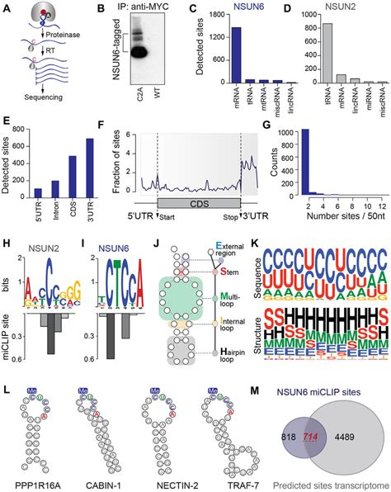
NSUN6
It belongs to the Nol1/Nop2/SUN domain (NSUN) of methyltransferase proteins that [inhibits/triggers/…] 5-methylcytosine (m⁵C) modifications.
NSUN2 & NSUN6 are the two main m⁵C writer proteins in mammalian mRNA but within different cells NSUN2 is the primary methyltransferase responsible for m⁵C deposition and in others it is NSUN6.
It is significant to the control of 5-Cytosine methylation and has associations with diseases including Dubowitz Syndrome and Autosomal Recessive Intellectual Development Disorder. NSUN6 expression has a potential relevance in cancer types.

Slide 4
Steps for Building Training Data Set
Pre-processed Data from Paper
Identify samples affected by NSUN6
Extend sequence
Generate structure information
Collect negative data set

Slide 5
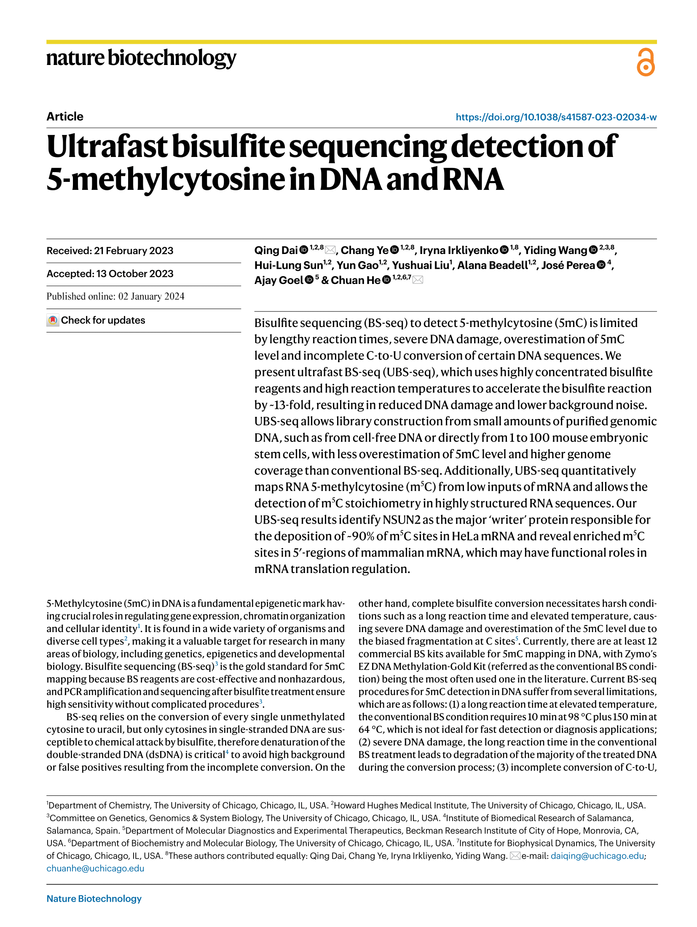
Basis Paper: m⁵C UB-Seq
Data used to train our model is sourced from a paper exploring the new DNA/RNA ‘Ultrafast Bisulfite’ sequencing technique.
Accelerates bisulfite reaction ~13-fold using highly concentrated reagents & high temperatures
Reduces DNA damage & lowers noise
Useful data for us as it provides less overestimation of m⁵C and higher genome coverage, and most significantly it can map m⁵C in RNA from low inputs of mRNA
Identified NSUN2 as the major ‘writer’ protein responsible for depositing ~90% of m5C sites in HeLa mRNA.
Dai, Q., Ye, C., Irkliyenko, I. et al. Ultrafast bisulfite sequencing detection of 5-methylcytosine in DNA and RNA. Nat Biotechnol (2024). https://doi.org/10.1038/s41587-023-02034-w

Slide 6
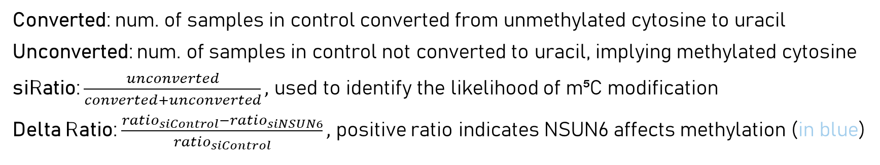
Processed Data From UBS-Seq Paper
Saves time, otherwise must compare RNA-Seq of regular sample & NSUN6 deprived sample and then process/map data with Linux.
Converted: num. of samples in control converted from unmethylated cytosine to uracil
Unconverted: num. of samples in control not converted to uracil, implying methylated cytosine
siRatio: $\frac{unconverted}{converted+unconverted},$ used to identify the likelihood of m⁵C modification
Delta Ratio: $\frac{ratio_{siControl}−ratio_{siNSUN6}}{ratio_{siControl}},$ positive ratio indicates NSUN6 affects methylation (in blue)
chrom | pos | strand | gene_type | gene_name | gene_pos | unconverted | converted | ratio_siControl | ratio_siNSUN6 | delta_ratio
1 | 944475 | + | protein_coding | ENSG00000187634(SAMD11) | 20553 | 152 | 197 | 0.435530086 | 0.570552147 | -31.0%
1 | 999131 | - | protein_coding | ENSG00000188290(HES4) | 1042 | 28 | 270 | 0.093959732 | 0.059440559 | 36.7%
1 | 1050461 | + | protein_coding | ENSG00000188157(AGRN) | 30342 | 9 | 267 | 0.032608696 | 0 | 100.0%
1 | 1304620 | - | protein_coding | ENSG00000131584(ACAP3) | 4990 | 7 | 1 | 0.875 | 1 | -14.3%

Slide 7
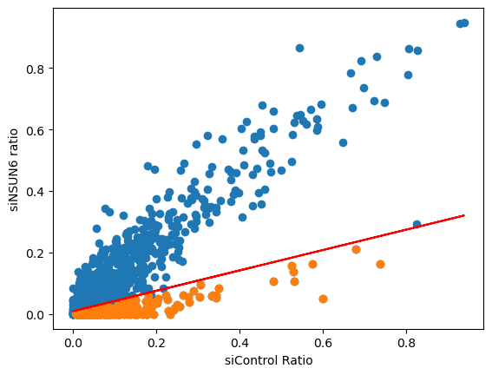
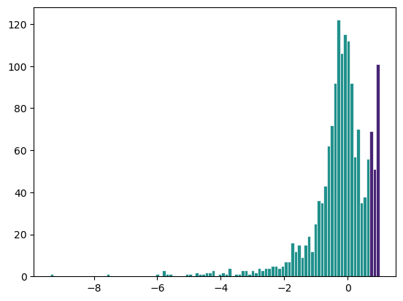
Pre-Processing Data
Preprocessing already applied
Trimmed adapter sequences and low-quality reads from library, 2140 genes
Mapped to reference sequence with hisat-3n tool
Required preprocessing
Remove genes not sampled enough unconverted+ converted > arbitrary value, when implemented 74.49% of genes retained (1594) using arbitrary value of 50.
Formally selecting genes likely methylated because of NSUN6 by observing delta ratio arbitrary value initially used but after extending sequence the entropy of the CUCCA motif can be analysed to show an optimised cut-off delta ratio
Ideal data threshold should be above delta ratio 0.6786
This threshold includes 228 samples, a 14.30% retention
Figure X, Histogram of data with likely-NSUN6 genes in the purple buckets
Figure X, Scatter plot of genes showing likely NSUN6 modified genes in orange

Slide 8
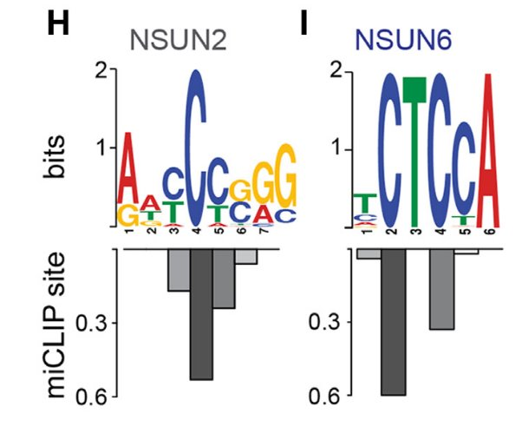
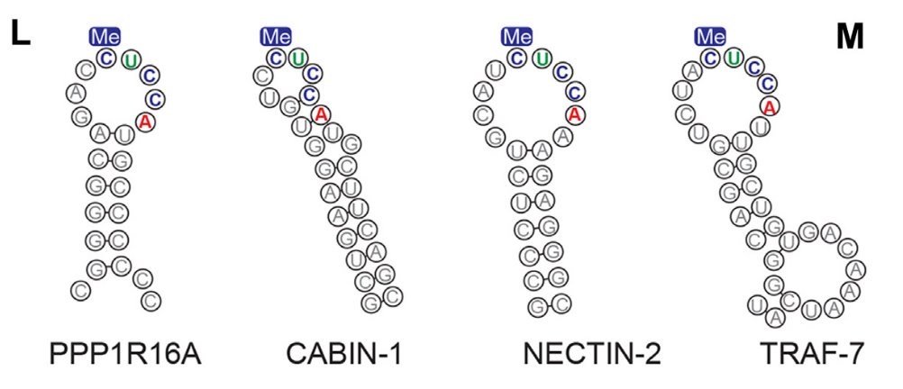
Known NSUN6 Motif: CUCCA
The consensus sequence motif recognized by NSUN6 is CTCCA, which is often found in loops of hairpin structures within the 3’UTR
Notes:
Journal club: NSUN6 substrates ​Trung Duc Nguyen​
2024/01/12​

Slide 9
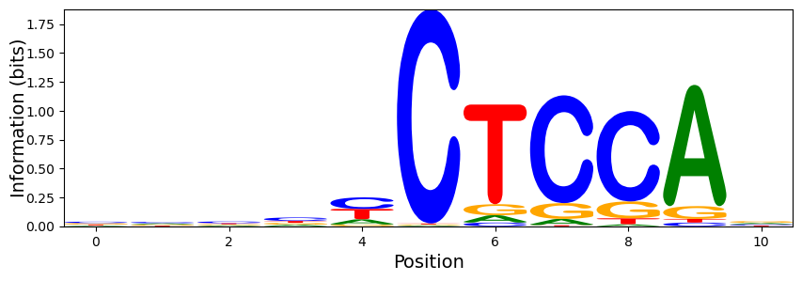
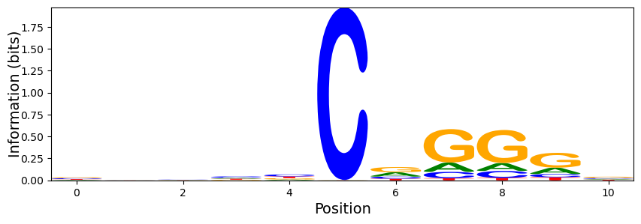
Extending Sequences
chrom | pos | strand
1 | 944475 | +
The sequence surrounding the methylated cytosine is a key variable for the model to identify NSUN6 modifiable motifs.
Extension performed using human genome (GRCH38) with Fasta by querying the gene’s chromosome and its position within the chromosome (‘pos’ designates the location of the cytosine).
Extensions with different selections around identified cytosine are collected to ensure motifs where identified cytosine is at the start/end are not missed (we collect 50:50, 30:70 & 70:30).
gene.get_seq(chrom,start+1,end,rc=(strand=='-’)).seq
Figure X, Sequence Logo showing entropy for likely NSUN6 affected genes (-5:5)
Figure X, Sequence Logo showing entropy for likely not NSUN6 affected genes (-5:5)

Slide 10
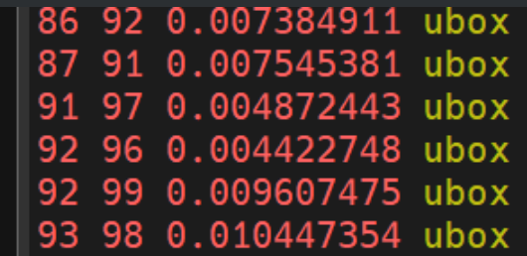
Structure Prediction*
With structural elements of RNA as variables in our model, we hope to identify rules for RNA structural elements that affects NSUN6 modifications.
Structure generated using Vienna RNA, we opted to create a script that used Vienna RNA’s log files to collect the base pairing probabilities for possible nucleotide pairs within the sequence(s).
The base pairing probabilities were collected as it provides more adjustable insights than a predicted structure otherwise generated by RNA Fold.
Figure X, A screenshot of the base pairing probabilities generated in the log files of RNA Fold
Pairing | Probability | Gene
1-85 | 0.004365742 | ENSG00000007376(RPUSD1)
1-87 | 0.025333378 | ENSG00000007376(RPUSD1)
1-92 | 0.005240112 | ENSG00000007376(RPUSD1)
1-94 | 0.008961728 | ENSG00000007376(RPUSD1)
Figure X, Sample of the collected base pairing data collected to represent structure

Slide 11
Positive Data Set
gene | seq | 1-77 | 1-80 | 1-92 | 1-94 | 1-99 | 1-100 | 2-7
ENSG00000188157(AGRN) | CCGACATCTGCCTCCGTGACTGTGACCACCCCAGGGCTCCTCCTGAGCCAGGCACTGCCGGCCCCCCCCGGCGCCCTCCCCCTGGCTCCCAGCAGTACCGC
ENSG00000083444(PLOD1) | AAGTTTTGGGGTAAAGACACCTGGATCAGACTCCAAGGGCTGCCCTGAGTCTGGGACTTCTGCCTCCATGGCTGGTCATGAGAGCAAACCGTAGTCCCCTG |  |  |  |  |  | 0.015831079 | 0.005156982
ENSG00000055070(SZRD1) | CAGCACAAGGAAAACCAGGAGAGAGTCTGCCTCCAGGACTCTGAGCCTTCTGCCTCGTATGTTCAGAAGGTGGATAGGTCTTCCCACTCCAGCATGGCTTG |  |  | 0.005635735
ENSG00000244038(DDOST) | TGCGGCCACTCCAGCACACGCAGTATGAGCGCTTCATCCCCTCGGCCTACCCCTACTACGCCAGCGCCTTCTCCATGATGCTGGGGCTCTTCATCTTCAGC | 0.014001347 |  | 0.048882638 | 0.927570497 | 0.012198666 | 0.013131569
Reformatted to have each gene with sequence and base-pairing data available for model to use.
Dimensional Reduction? Sliding Windows
Notes:
Aggregated Features: Aggregate probabilities over specific regions (e.g., sliding windows) to reduce dimensionality. For example, compute the mean, variance, or entropy of probabilities within a window.

Slide 12
[Generating Negative Data Set]
Collect raw data
Remove those with CUCCA motif
Remove genes appearing in positive data set
Map with genome
Extend sequence/Get base pairing probabilities
Randomly select a subset from this data set

Slide 13
Next: Creating Model
Target: Binary classification/label (affected by NSUN6 or not)
Evaluation: Split positive & negative dataset into train & test (75:25)
Support Vector Machine (SVM) is a powerful model for binary classification. [Best model for binary classification, more familiar]
Gradient Boosting (such as XGBoost) models can handle complex interactions and reflect feature importance. [Good with missing data, such as invalid pairings…]
Can also consider Random Forest?
Busy until 10th may, prime period 11th->21st

